Slide 1
Lecture 6
Data Flow Diagram (DFD)

Slide 2
Learning Goals
In this module we will learn
What are Data Flow Diagrams (DFDs)?
Why they are useful?
How are they developed?
How to level DFDs?
Good style conventions in developing DFDs
Difference between Logical and Physical DFDs
Tools available to draw DFDs

Slide 3
Flow-Oriented Modeling
Represents how data objects are transformed at they move through the system.
Data flow diagram (DFD) is the diagrammatic form that is used.
Considered by many to be an “old school” approach, but continues to provide a view of the system that is unique—it should be used to supplement other analysis model elements.

Slide 4
Why DFD?
If a DFD is too detailed it will have too many data flows and will be large and difficult to understand
Start from a broad overview. Expand to details - Idea similar to using procedures and linking these with a main program
Each DFD must deal with one aspect of a big system

Slide 5
The Flow Model
Every computer-based system is an
information transform ....
computer
based
system
input
output

Slide 6
Data Flow Diagrams
WHAT ARE DATA FLOW DIAGRAMS?
DFDs models the system by depicting
External entities from which the data flows and where results terminate
Processes which transform data flows
Data stores from which the data are read or into which data are written by the processes.

Slide 7
Flow Modeling Notation
External Entity
Process
Data flow
Data store

Slide 8
External Entity
A producer or consumer of data
Examples: a person, a device, a sensor
Another example: computer-based system
Data must always originate somewhere and must always be sent to something

Slide 9
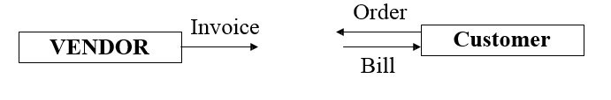
Example: External Entity
A Rectangle represents an external entity
They either supply data or receive data
They do not process data

Slide 10
Process
A data transformer (changes input
to output)
Examples: compute taxes, determine area, format report, display graph
Data must always be processed in some
way to achieve system function

Slide 11
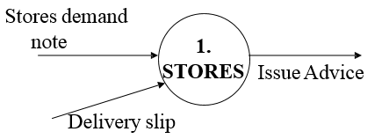
Example: Process
A circle represents a process
Straight lines with incoming arrows are input data flows
Straight lines with outgoing arrows are output data flows
Processes are given serial numbers for easy reference
Labels are assigned to Data flow.

Slide 12
Data Flow
Data flows through a system, beginning
as input and transformed into output.
base
compute
triangle
area
area
height

Slide 13
Data Stores
Data is often stored for later use.
sensor #
sensor #, type,
location, age
look-up
sensor
data
report required
type,
location, age
sensor number
sensor data

Slide 14
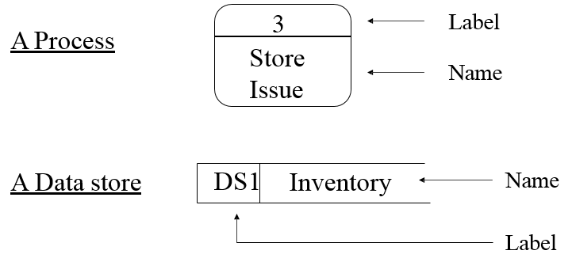
DFD Notation

Slide 15
DFD Rules and Tips
Each process should have at least one input and an output.
Each data store should have at least one data flow in and one data flow out.
Data stored in a system must go through a process.
All processes in a DFD go to another process or a data store.

Slide 16
Cont…
Data can flow from
-external entity to process
-process to external entity
-process to store and back
-process to process
Data cannot flow from
-external entity to external entity
-external entity to store
-store to external entity
-store to store

Slide 17
Good style in drawing DFD
Use meaningful names for data flows, processes and data stores.
Use top down development starting from context diagram and successively levelling DFD
Only previously stored data can be read
A process can only transfer input to output. It cannot create new data
Data stores cannot create new data

Slide 18
DFD levels and layers:
From context diagrams to pseudocode
A data flow diagram can dive into progressively more detail by using levels and layers, zeroing in on a particular piece.
DFD levels are numbered 0, 1 or 2, and occasionally go to even Level 3 or beyond.

Slide 19
DFD 0
DFD Level 0 is also called a Context Diagram. It’s a basic overview of the whole system or process being analyzed or modeled.
It’s designed to be an at-a-glance view, showing the system as a single high-level process, with its relationship to external entities.
It should be easily understood by a wide audience, including stakeholders, business analysts, data analysts and developers.

Slide 20
DFD 0
DFD Level 0 is also called a Context Diagram. It’s a basic overview of the whole system or process being analyzed or modeled.
It’s designed to be an at-a-glance view, showing the system as a single high-level process, with its relationship to external entities.
It should be easily understood by a wide audience, including stakeholders, business analysts, data analysts and developers.

Slide 21
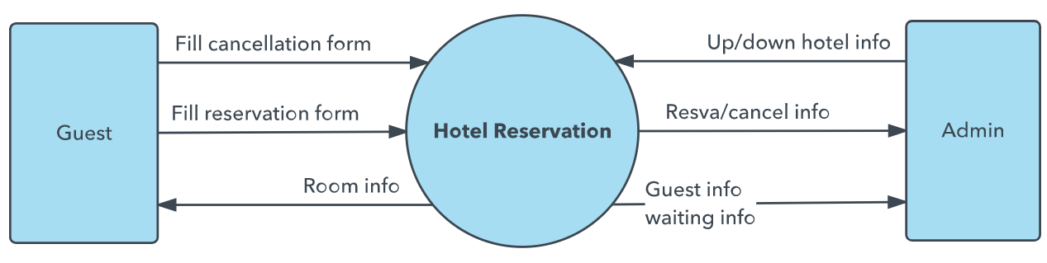
DFD 0

Slide 22
DFD-1
DFD Level 1 provides a more detailed breakout of pieces of the Context Level Diagram.
You will highlight the main functions carried out by the system, as you break down the high-level process of the Context Diagram into its sub-processes.

Slide 23
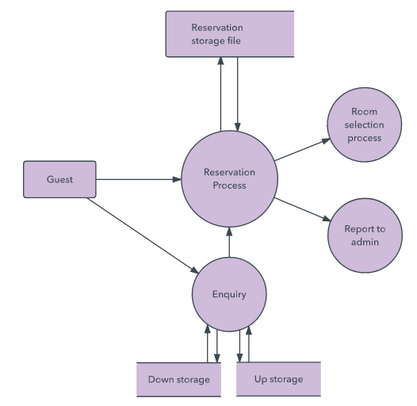
DFD-1

Slide 24
DFD-2
DFD Level 2 then goes one step deeper into parts of Level 1.
It may require more text to reach the necessary level of detail about the system’s functioning.

Slide 25
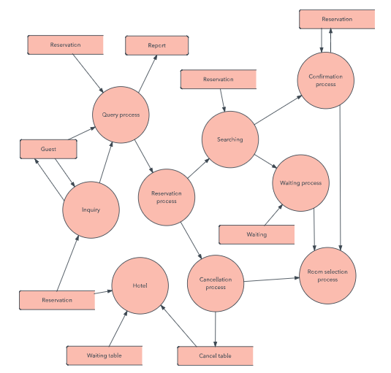
DFD-2

Slide 26
DFD 3, 4
Progression to Levels 3, 4 and beyond is possible, but going beyond Level 3 is uncommon.
Doing so can create complexity that makes it difficult to communicate, compare or model effectively.

Slide 27
Leveling Rules
If process p is expanded, the process at the next level are labeled as p.1,p.2 etc.
All data flow entering or leaving p must also enter or leave its expanded version.
Expanded DFD may have data stores
No external entity can appear in expanded DFD
Keep the number of processes at each level less than

Slide 28
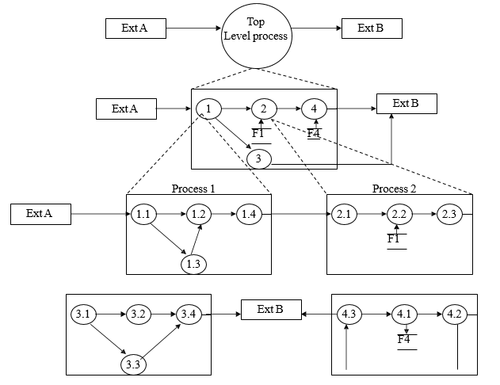
DFD levels and layers

Slide 29
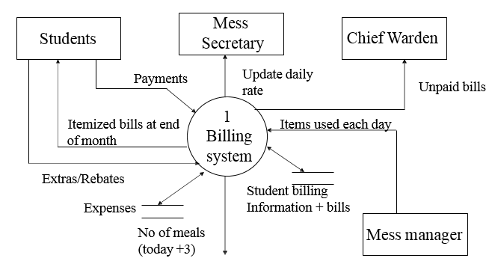
Example: Billing System
Going to next process (Continued in next slide)

Slide 30
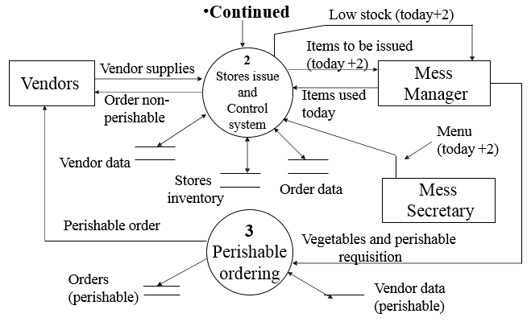
Example: Billing System(Cont…)

Slide 31
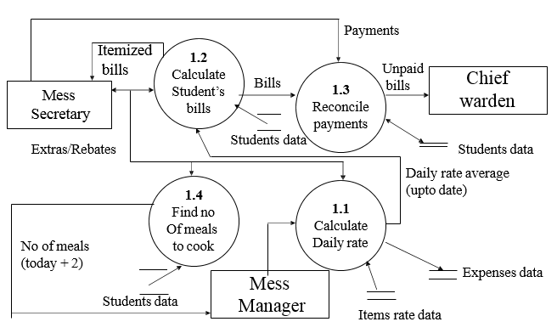
Example: Billing System (Cont…)

Slide 32
Illegal Constructs In DFD
No loops are allowed in DFD
A process cannot be a pure decision
A single data flow should not be split into many flows with different labels
No data flow allowed between data stores

Slide 33
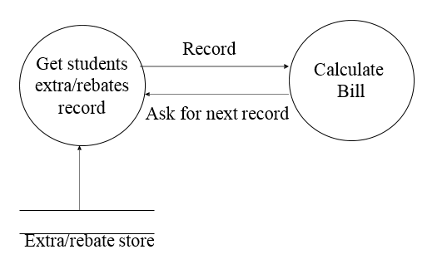
Illegal Constructs In DFD
Not correct as loop is formed

Slide 34
Logical DFD vs. Physical DFD
A Logical DFD visualizes the data flow that is essential for a business to operate.
It specifies who does the operations specified by the logical DFD
A Physical DFD shows how the system is actually implemented now.
A physical DFD is similar to a document flow diagram.
Physical DFD may depict physical movements of the goods
Physical DFDs can be drawn during fact gathering phase of a life cycle

Slide 35
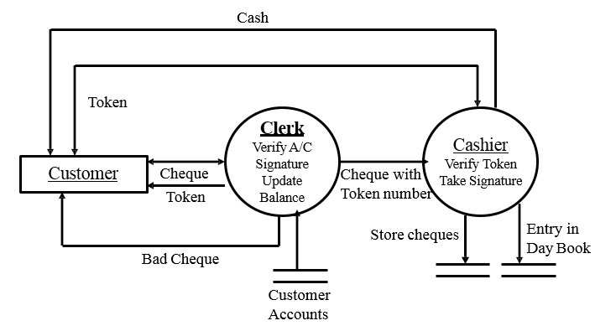
Physical DFD for Cheque Encashment

Slide 36
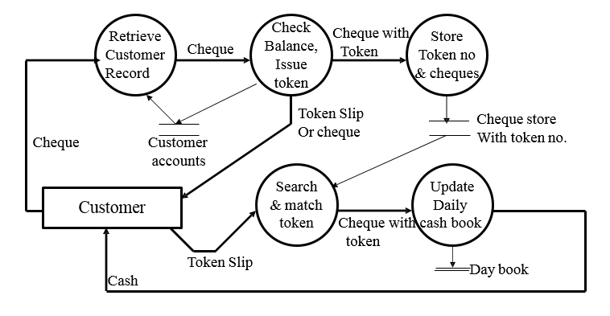
Logical DFD for Cheque Encashment

Slide 37
Thank You !!

